Slide 1
Dynamically Routing UAVs in the Aftermath of a Severe Tornado
PROLOG 2019
Sean Grogan
Robert Pellerin
Michel Gamache
2019

Slide 2
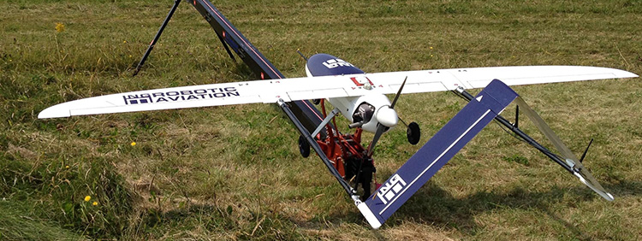
Presentation Outline
Past work and limitations of past work
Some relevant literature
The new plan
A naive policy
Next steps

Slide 3
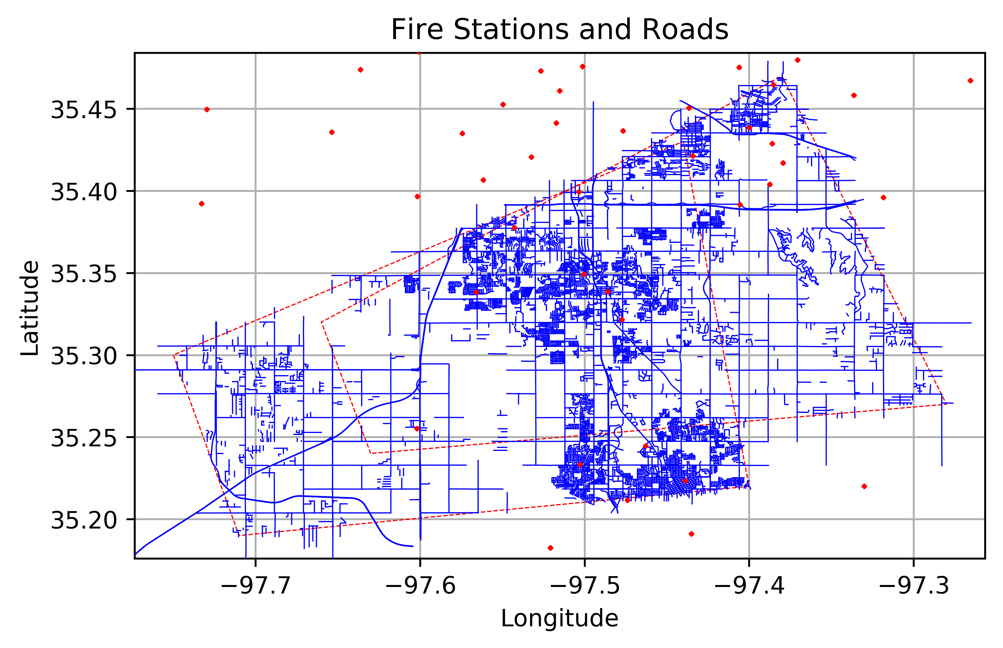
Past Work and Context
Allocates and routes semi-autonomous UAVs with weather data and geospatial indicators
Weather warnings
Severe weather sightings
Roads
Uses a fixed wing, gas-powered UAV
Notes:
B

Slide 4
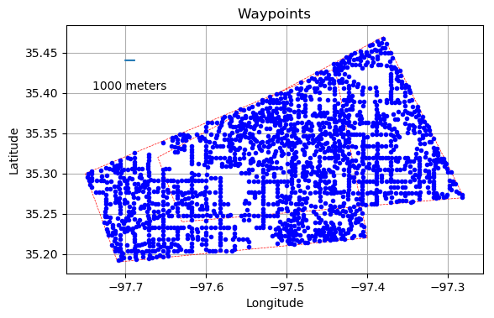
Past Work and Context : Data Generation
Fire Station | SBW | LSR
Where drones are launched and retrieved, aka ‘depots’ | The box indicating severe weather | A sighting of severe weather

Slide 5
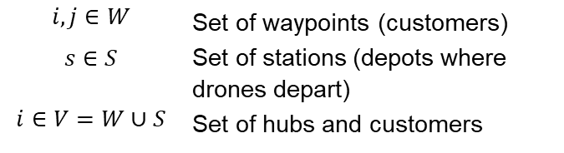

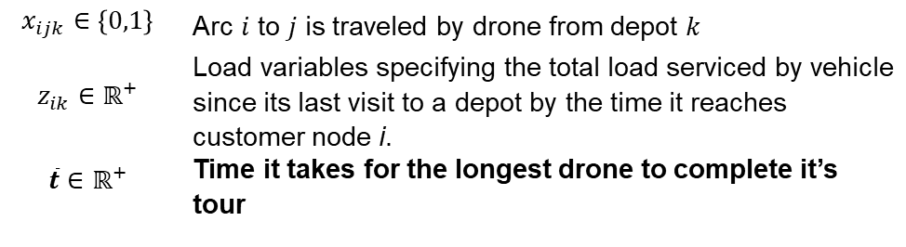
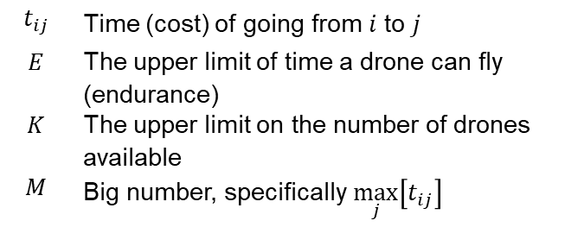
DCVRP: Problem Formulation and Constraints (1/2)
Sets:
Parameters:
$$i,j∈W$$ | Set of waypoints (customers)
$$s∈S$$ | Set of stations (depots where drones depart)
$$i∈V=W∪S$$ | Set of hubs and customers
$$t_{ij}$$ | Time (cost) of going from $i$ to $j$
$$E$$ | The upper limit of time a drone can fly (endurance)
$$K$$ | The upper limit on the number of drones available
$$M$$ | Big number, specifically $\max_{j}\left[t_{ij}\right]$
Variables:
$$x_{ijk}∈\left\{0,1\right\}$$ | Arc $i$ to $j$ is traveled by drone from depot $k$
$$z_{ik}∈ℝ^{+}$$ | Load variables specifying the total load serviced by vehicle since its last visit to a depot by the time it reaches customer node i.
$$\overline{t}∈ℝ^{+}$$ | Time it takes for the longest drone to complete it’s tour

Slide 6
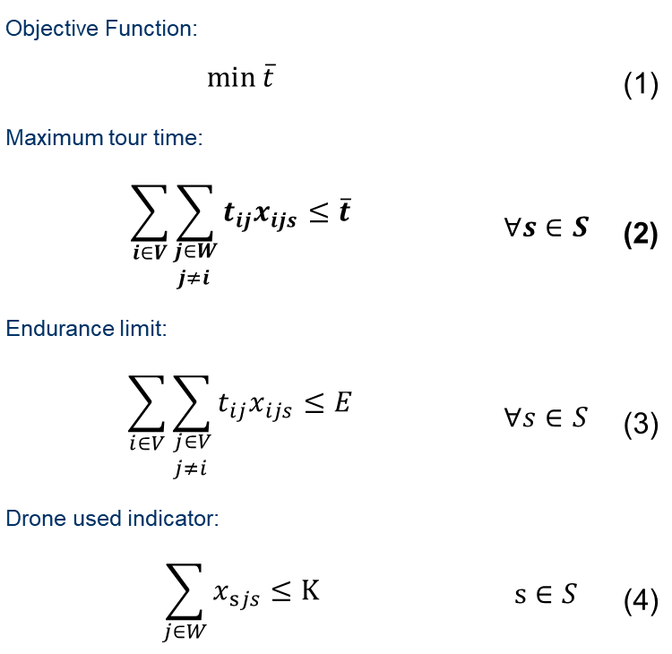
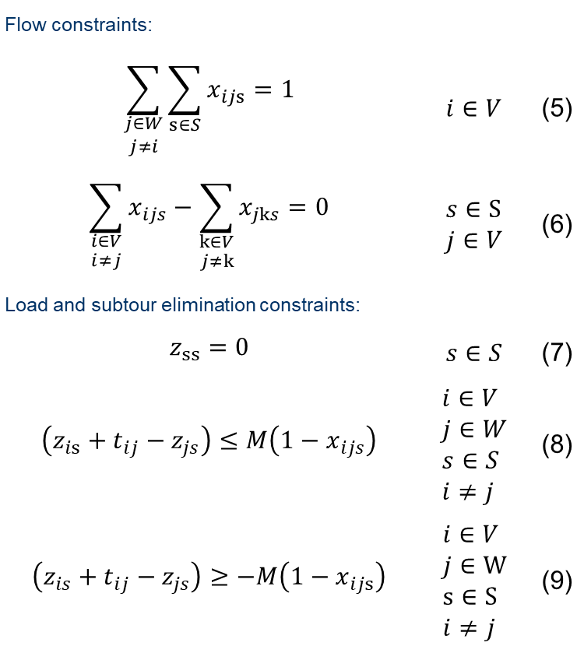
DCVRP: Past Problem Formulation and Constraints (2/2)
Objective Function:
$$\min{\overline{t}}$$ |  | (1)
Maximum tour time:
$$\sum_{i∈V}{\sum_{\begin{aligned}j∈W \\ j≠i \end{aligned}}{t_{ij}x_{ijs}}}≤\overline{t}$$ | $$∀s∈S$$ | (2)
Endurance limit:
$$\sum_{i∈V}{\sum_{\begin{aligned}j∈V \\ j≠i \end{aligned}}{t_{ij}x_{ijs}}}≤E$$ | $$∀s∈S$$ | (3)
Drone used indicator:
$$\sum_{j∈W}{x_{sjs}}≤K$$ | $$s∈S$$ | (4)
Flow constraints:
$$\sum_{\begin{aligned}j∈W \\ j≠i\end{aligned}}{\sum_{s∈S}{x_{ijs}}}=1$$ | $$i∈V$$ | (5)
$$\sum_{\begin{aligned}i∈V \\ i≠j\end{aligned}}{x_{ijs}}−\sum_{\begin{aligned}k∈V \\ j≠k\end{aligned}}{x_{jks}}=0$$ | $$s∈S \\ j∈V$$ | (6)
Load and subtour elimination constraints:
$$z_{ss}=0$$ | $$s∈S$$ | (7)
$$\left(z_{is}+t_{ij}−z_{js}\right)≤M\left(1−x_{ijs}\right)$$ | $$i∈V \\ j∈W \\ s∈S \\ i≠j$$ | (8)
$$\left(z_{is}+t_{ij}−z_{js}\right)≥−M\left(1−x_{ijs}\right)$$ | $$i∈V \\ j∈W \\ s∈S \\ i≠j$$ | (9)
Notes:
(8) And (9) are a linear combo of $\sum_{i∈V}{\sum_{s∈S}{x_{ijs}\left(z_{is}−z_{js}+d_{j}\right)}}=0 ∀j∈W$

Slide 7
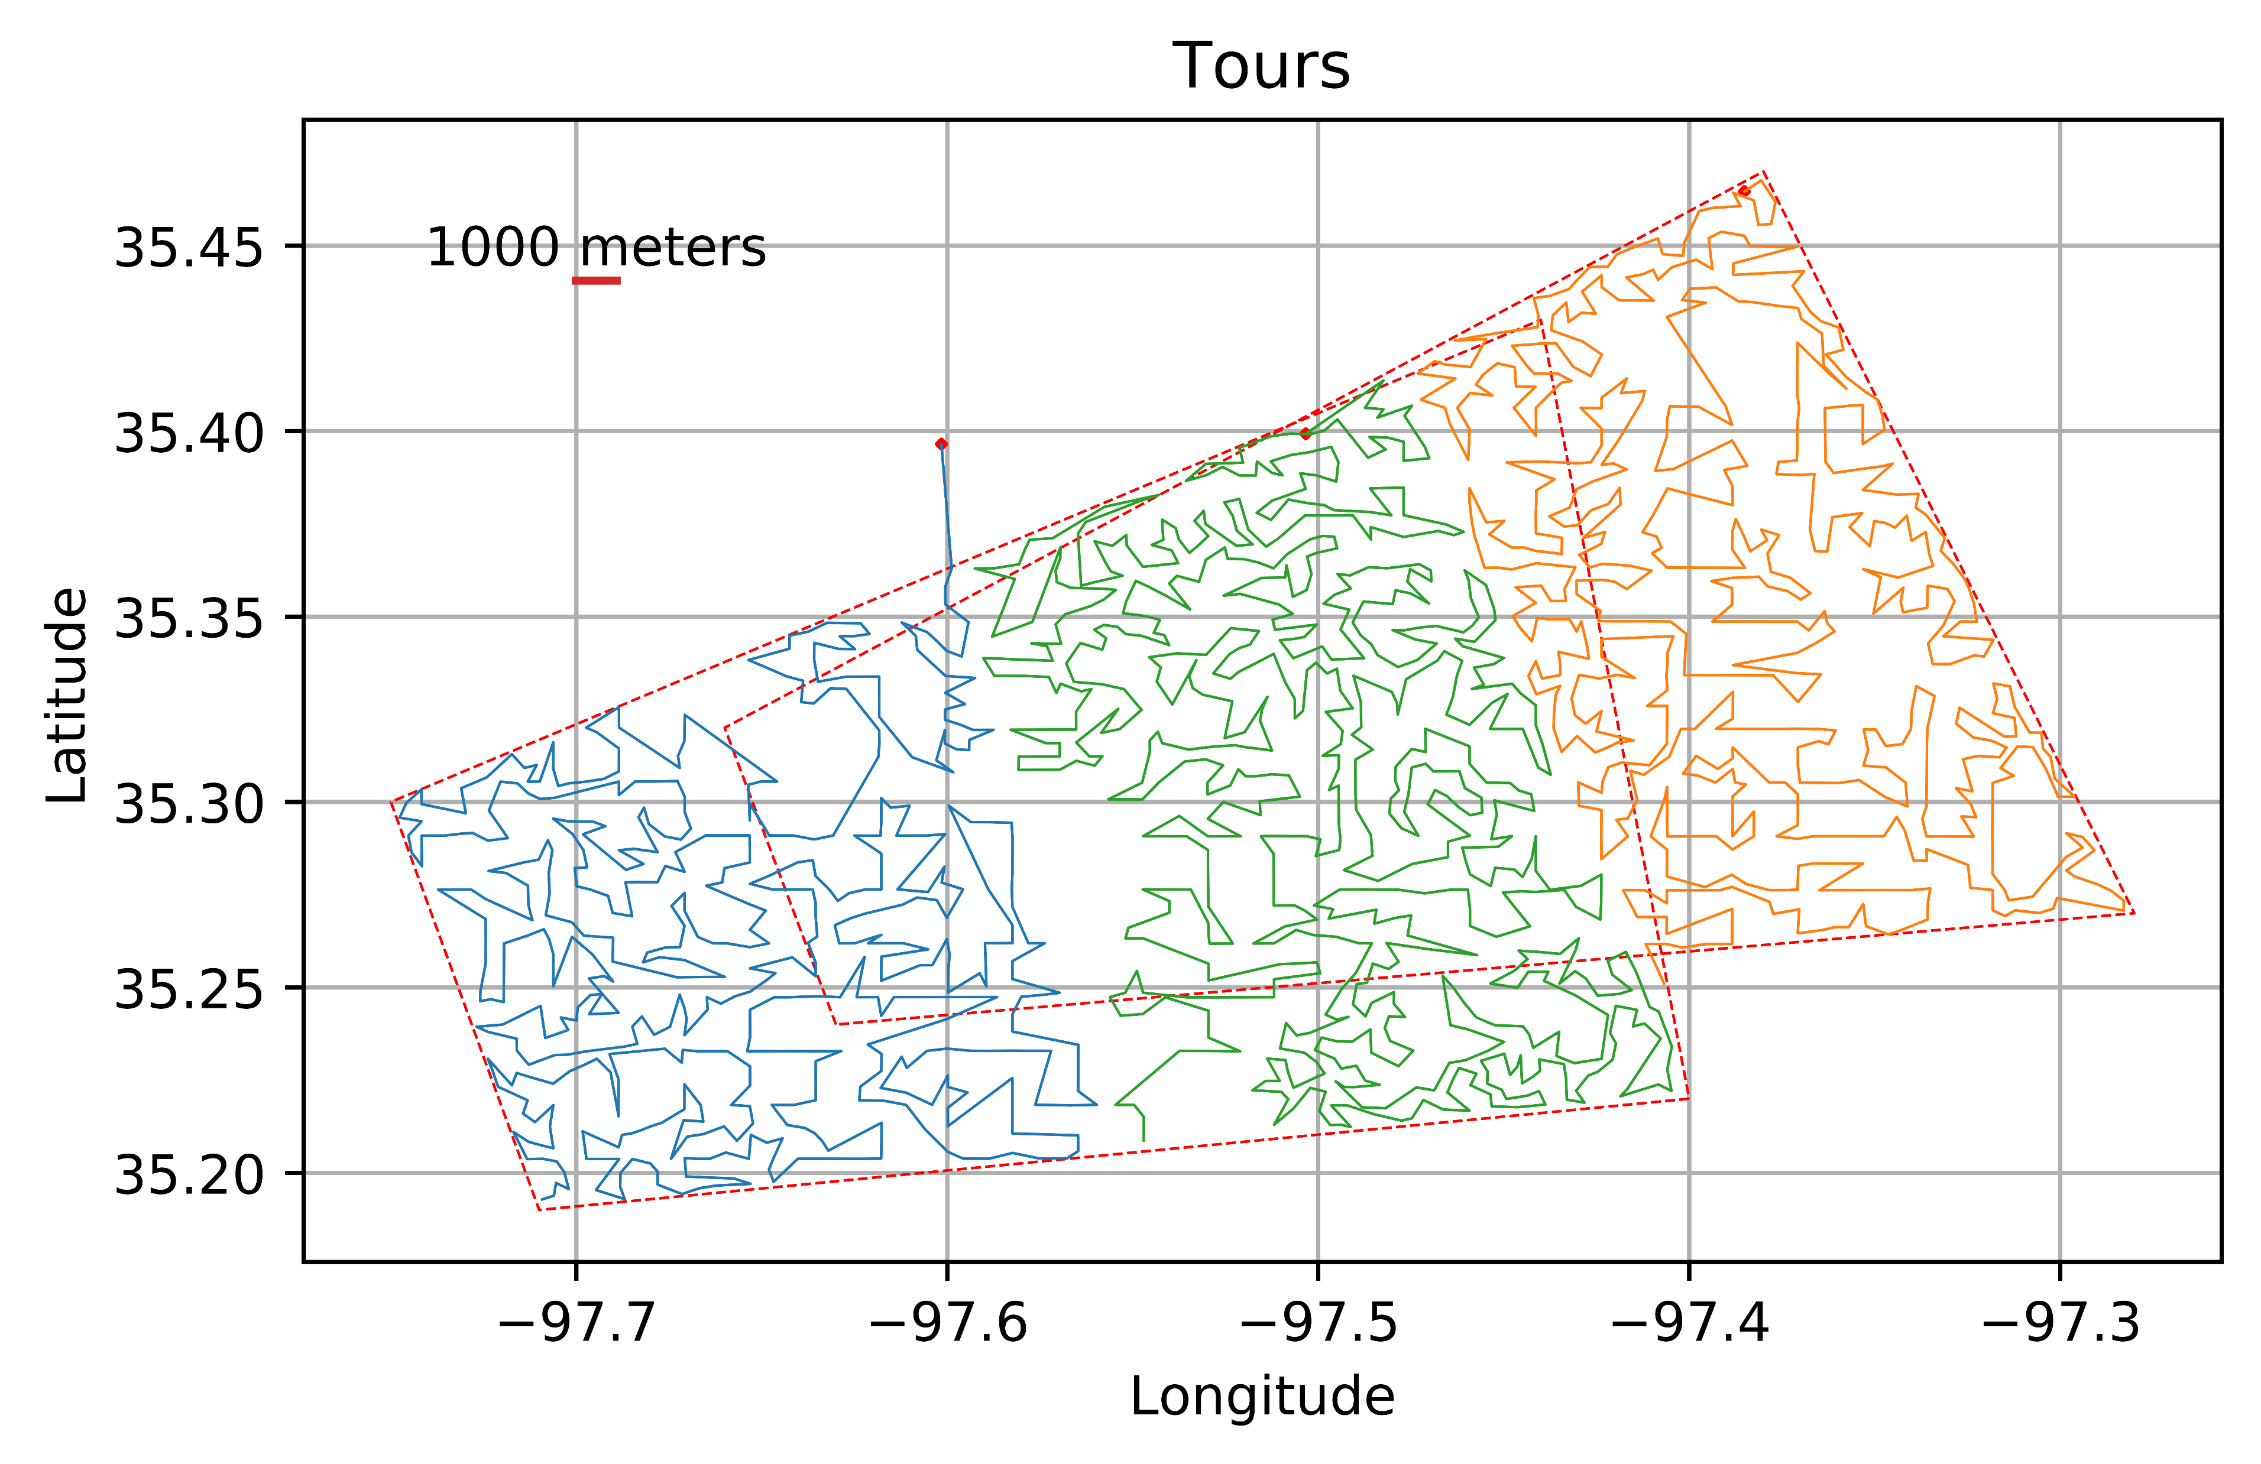
Limitations
What was done
What are the Limits
Demonstration of data available and its use to allocate and route UAVs
Proposed a multi-depot VRP with an objective function that minimized the time it took to search the entire area
Do not need entire area
Identify where damage is quickly as possible

Slide 8
Relevant literature
Reviewing literature with the following attributes:
Wilderness or Urban SAR or Combat Environments
Autonomous or semi-autonomous flying vehicles, with preference to fixed wing aircraft
No preference to disaster type
Common tools are decision policies (Combat/Military) and pre-planned routes (SAR)
Most applicable article from the literature is using a fleet UAVs in a combat environment
Radio silence, uses a region sharing strategy, pre-planned route, and a decision policy to react to information
Xia, Y., Batta, R., & Nagi, R. (2017). Controlling a Fleet of Unmanned Aerial Vehicles to Collect Uncertain Information in a Threat Environment. Operations Research, 65(3), 674–692. https://doi.org/10.1287/opre.2017.1590

Slide 9
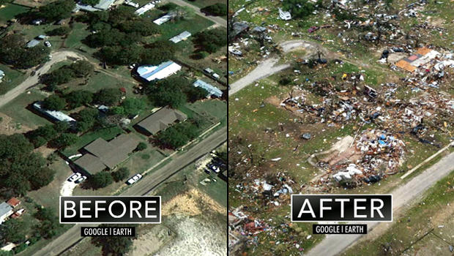
The New Plan
Create an initial route as before
Conjecture: The best indicator of damage is damage
As drones search the area, operators can begin to uncover and identify damage
Rescuers can be dispatched when damage is identified
If damage is identified in a given area, it increases the likelihood an adjacent area(s) will have damage.
A satellite photo of Granbury, Texas before and after a 200 mph-tornado ripped through the area Wednesday night. CBS NEWS/GOOGLE MAPS
Notes:
https://www.cbsnews.com/news/twisters-with-up-to-200-mph-winds-roar-through-north-texas-killing-6/

Slide 10
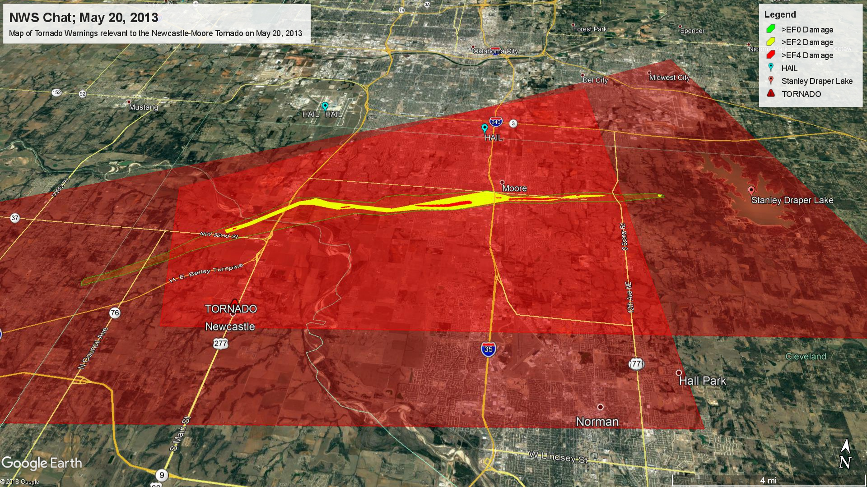
A Naive Policy
Consider most tornadoes in the continental United States move in a west-to-east or southwest-to-northeast direction
A naïve policy would be to fly in a north-south pattern until damage is identified, then fly east-west to uncover the extent of the damage
N

Slide 11
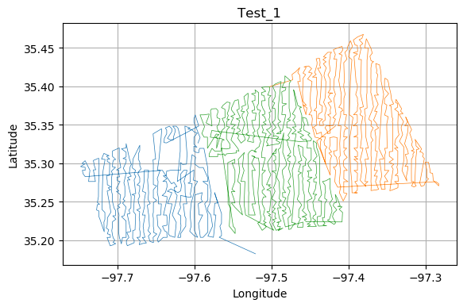
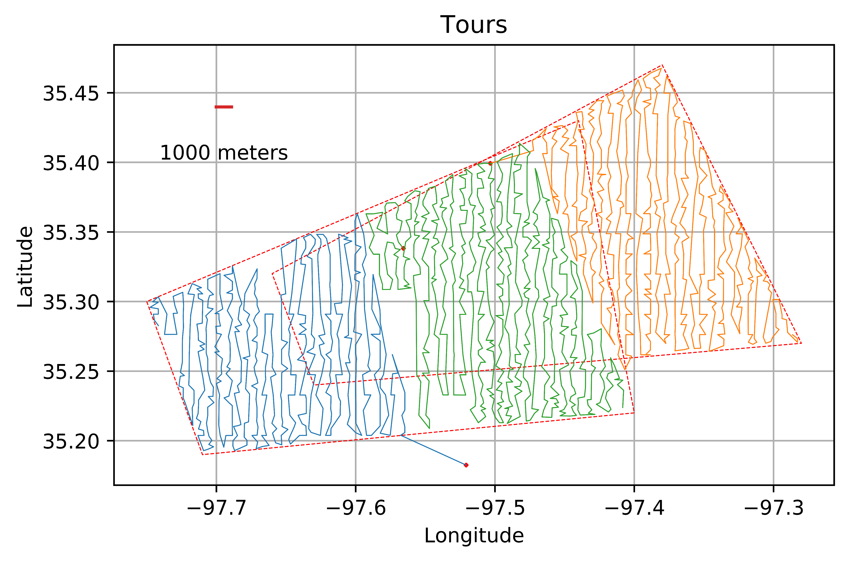
Testing a Naive Policy

Slide 12
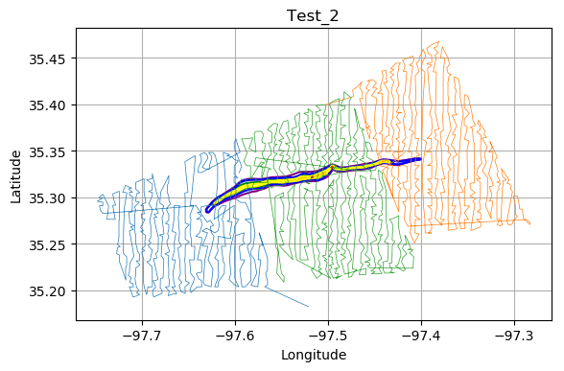
Testing a Naive Policy

Slide 13
Conclusion and Next Steps
The naive policy reacts to ‘seeing’ damage
Where Damage Occurred (on average)…
Regions with EF5 and EF4 damage could be dispatched up to 45 mins earlier.
EF3 was 10 mins slower, Less damage up to 30 mins later.
But we can do better!
Notes:
EF5: [-60, -57, -54], EF4: [-107, -45, 12] EF3: [-74, 7, 200] EF2 [-17.3079 -75.7184 73.35125 ] EF1 [37.40018 -90.1924 272.0009 ] EF0[-4.32586 -84.2701 196.8784 ]

Slide 14
Next Steps
Leverage the data and expertise of how Meteorologists draw storm warnings could mean we can better dynamically route the UAVs
Potential to look at typical paths Tornadoes take and other patterns in the weather data
Adjusting how the Dynamic UAV Routing works when no damage is uncovered at a waypoint
I.e. travel to the next possible waypoint with damage rather than returning to the north-south pattern

Slide 15
Thank You!

